Slide 1





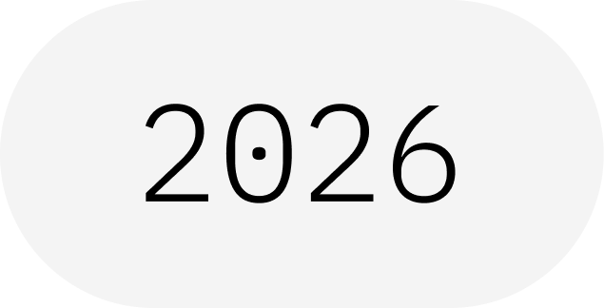
Estimator Primitive
From Circuits to Expectation Values
IBM Quantum School
Saad Ejaz • Guest Speaker
Qiskit Fall Fest 2026 at University of Engineering & Technology Lahore,Narowal Campus

Slide 2
01
SPEAKER INTRODUCTION
Saad Ejaz
Guest Speaker
Computer Engineering student and IBM Quantum School tutor, introducing the Estimator primitive and how it computes expectation values of observables.
IBM Quantum School
Qiskit Fall Fest 2026 at University of Engineering & Technology Lahore,Narowal Campus

Slide 3
02
TABLE OF CONTENTS
01
What Is the Estimator?
02
The Estimator Workflow
03
Inputs: The PUB
04
Outputs: Expectation Values
05
Basic Qiskit Implementation
06
Takeaways & Resources
Qiskit Fall Fest 2026 at University of Engineering & Technology Lahore,Narowal Campus

Slide 4

WHAT IS A QISKIT FALL FEST?
03
A beginner-friendly session on the Estimator primitive: how to measure a property of a quantum state and read back its expectation value.
Qiskit Fall Fest 2026 at University of Engineering & Technology Lahore,Narowal Campus

Slide 5
04
INTRODUCTION
01
Qiskit Fall Fest 2026 at University of Engineering & Technology Lahore,Narowal Campus

Slide 6
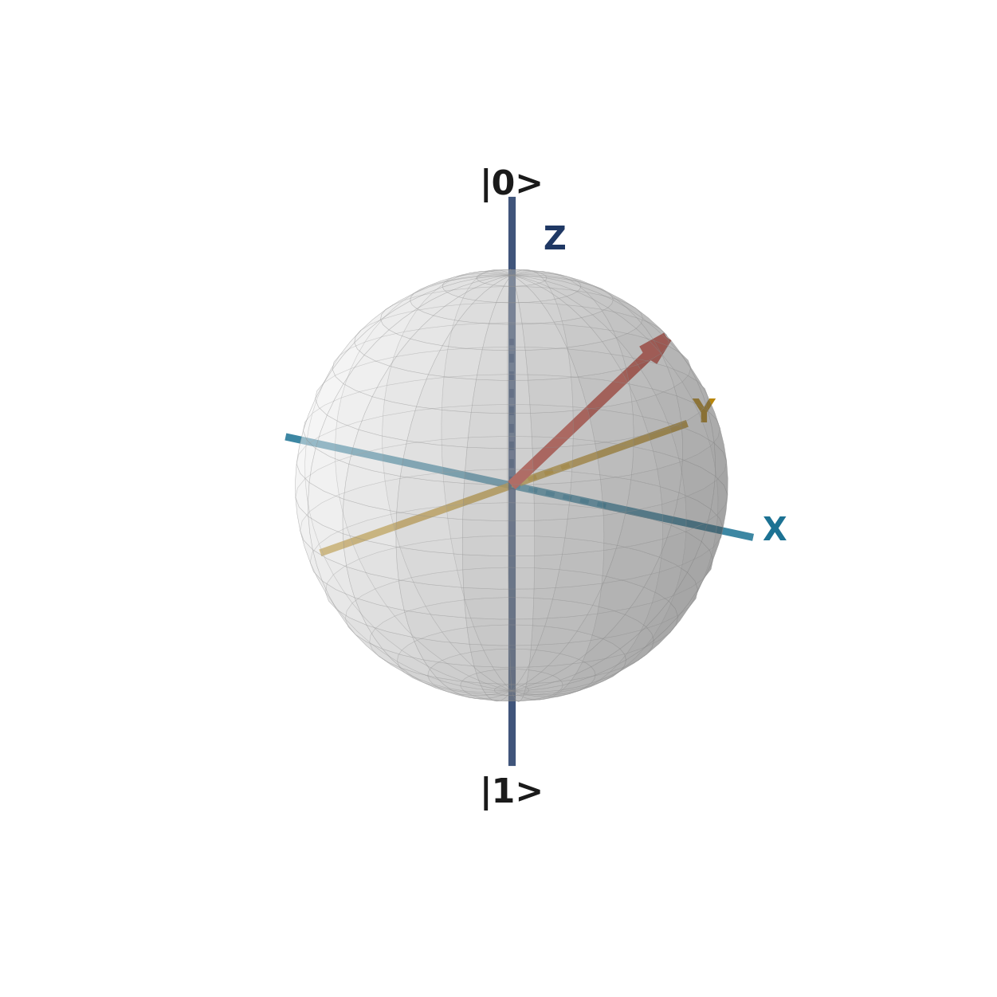
05
WHAT IS THE ESTIMATOR?
The Estimator measures a property of your state.
CIRCUIT + OBSERVABLE
It computes the expectation value of an observable for the state your circuit prepares.
You do not add measurements to the circuit yourself.
ESTIMATOR
EXPECTATION VALUE
Qiskit Fall Fest 2026 at University of Engineering & Technology Lahore,Narowal Campus

Slide 7
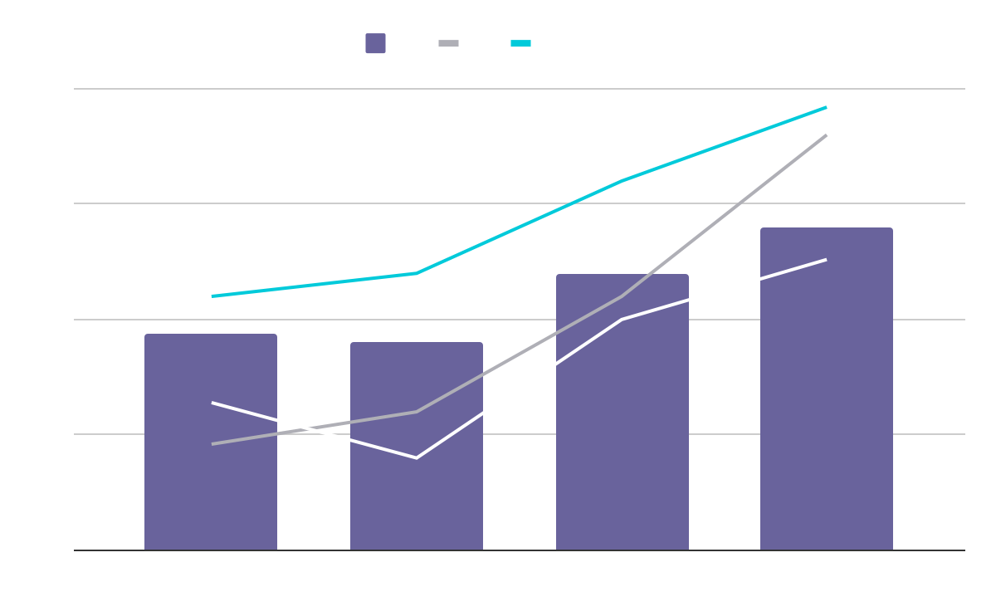
THE ESTIMATOR WORKFLOW
01
02
03
04
Build
Transpile
Run
Read
Create a circuit and an observable.
Match both to the chosen device.
Send the circuit and observable to the Estimator.
Get expectation values and standard errors.
The Estimator returns numbers: expectation values, not raw bitstrings.
Qiskit Fall Fest 2026 at University of Engineering & Technology Lahore,Narowal Campus

Slide 8
07
INPUTS & OUTPUTS
02
Qiskit Fall Fest 2026 at University of Engineering & Technology Lahore,Narowal Campus

Slide 9
08
INPUT: THE PUB
Each job is a list of PUBs. A PUB bundles a circuit with what to estimate.
CIRCUIT
OBSERVABLES
PARAMETERS
Prepares the state
What to estimate
Optional values
The circuit builds the state to study. No measurements needed.
Operators such as Pauli strings (for example ZZ), written as SparsePauliOp.
Bind values to a parametrized circuit to sweep many settings in one job.
Qiskit Fall Fest 2026 at University of Engineering & Technology Lahore,Narowal Campus

Slide 10
09
OUTPUT: EXPECTATION VALUES
VALUES
ERRORS
The expectation values are stored in data.evs.
Standard errors in data.stds show the uncertainty of each value.
KEY POINT
Set a target precision to control the shots used. A smaller precision needs more shots.
Qiskit Fall Fest 2026 at University of Engineering & Technology Lahore,Narowal Campus

Slide 11
10
ESTIMATOR OR SAMPLER?
Choose by the question you ask.
ESTIMATOR
Use the Estimator to get expectation values of observables.
Use the Sampler to see the full distribution of outcomes.
Returns expectation values of observables.
SAMPLER
Returns bitstrings and their counts.
Qiskit Fall Fest 2026 at University of Engineering & Technology Lahore,Narowal Campus

Slide 12
11
WHEN TO USE THE ESTIMATOR
ENERGY ESTIMATES
VARIATIONAL ALGORITHMS
Chemistry problems estimate the energy of a state.
Methods like VQE tune parameters to minimize an expectation value.
PARAMETER SWEEPS
ERROR MITIGATION
Run many parameter settings in a single job.
Qiskit Runtime has built-in options that reduce noise in estimates.
Qiskit Fall Fest 2026 at University of Engineering & Technology Lahore,Narowal Campus

Slide 13
12
IMPLEMENTATION
03
Qiskit Fall Fest 2026 at University of Engineering & Technology Lahore,Narowal Campus

Slide 14
13
BASIC QISKIT IMPLEMENTATION
EXAMPLE: BELL STATE
# 1. Build a Bell circuit and an observable
qc = QuantumCircuit(2)
qc.h(0); qc.cx(0, 1)
obs = SparsePauliOp("ZZ")
# 2. Transpile the circuit and the observable
backend = QiskitRuntimeService().least_busy(simulator=False)
pm = generate_preset_pass_manager(
optimization_level=3, backend=backend)
isa_qc = pm.run(qc)
isa_obs = obs.apply_layout(isa_qc.layout)
# 3. Run with the Estimator primitive
estimator = EstimatorV2(mode=backend)
job = estimator.run([(isa_qc, isa_obs)])
# 4. Read the expectation value
print(job.result()[0].data.evs)
The ideal ZZ value is 1. Imports are omitted for space.
1 Build
2 Transpile
3 Run
4 Read
Qiskit Fall Fest 2026 at University of Engineering & Technology Lahore,Narowal Campus

Slide 15
14
RESOURCES
IBM QUANTUM LEARNING
Qiskit Runtime primitives and Estimator examples.
QISKIT DOCUMENTATION
EstimatorV2 reference and primitive inputs and outputs (PUBs).
KEY TAKEAWAY
The Estimator returns expectation values with standard errors.
Qiskit Fall Fest 2026 at University of Engineering & Technology Lahore,Narowal Campus

Slide 16
THANKS!
DO YOU HAVE ANY QUESTIONS?
15
Saad Ejaz • Guest Speaker
IBM Quantum School
Qiskit Fall Fest 2026 at University of Engineering & Technology Lahore,Narowal Campus

